Slide 1

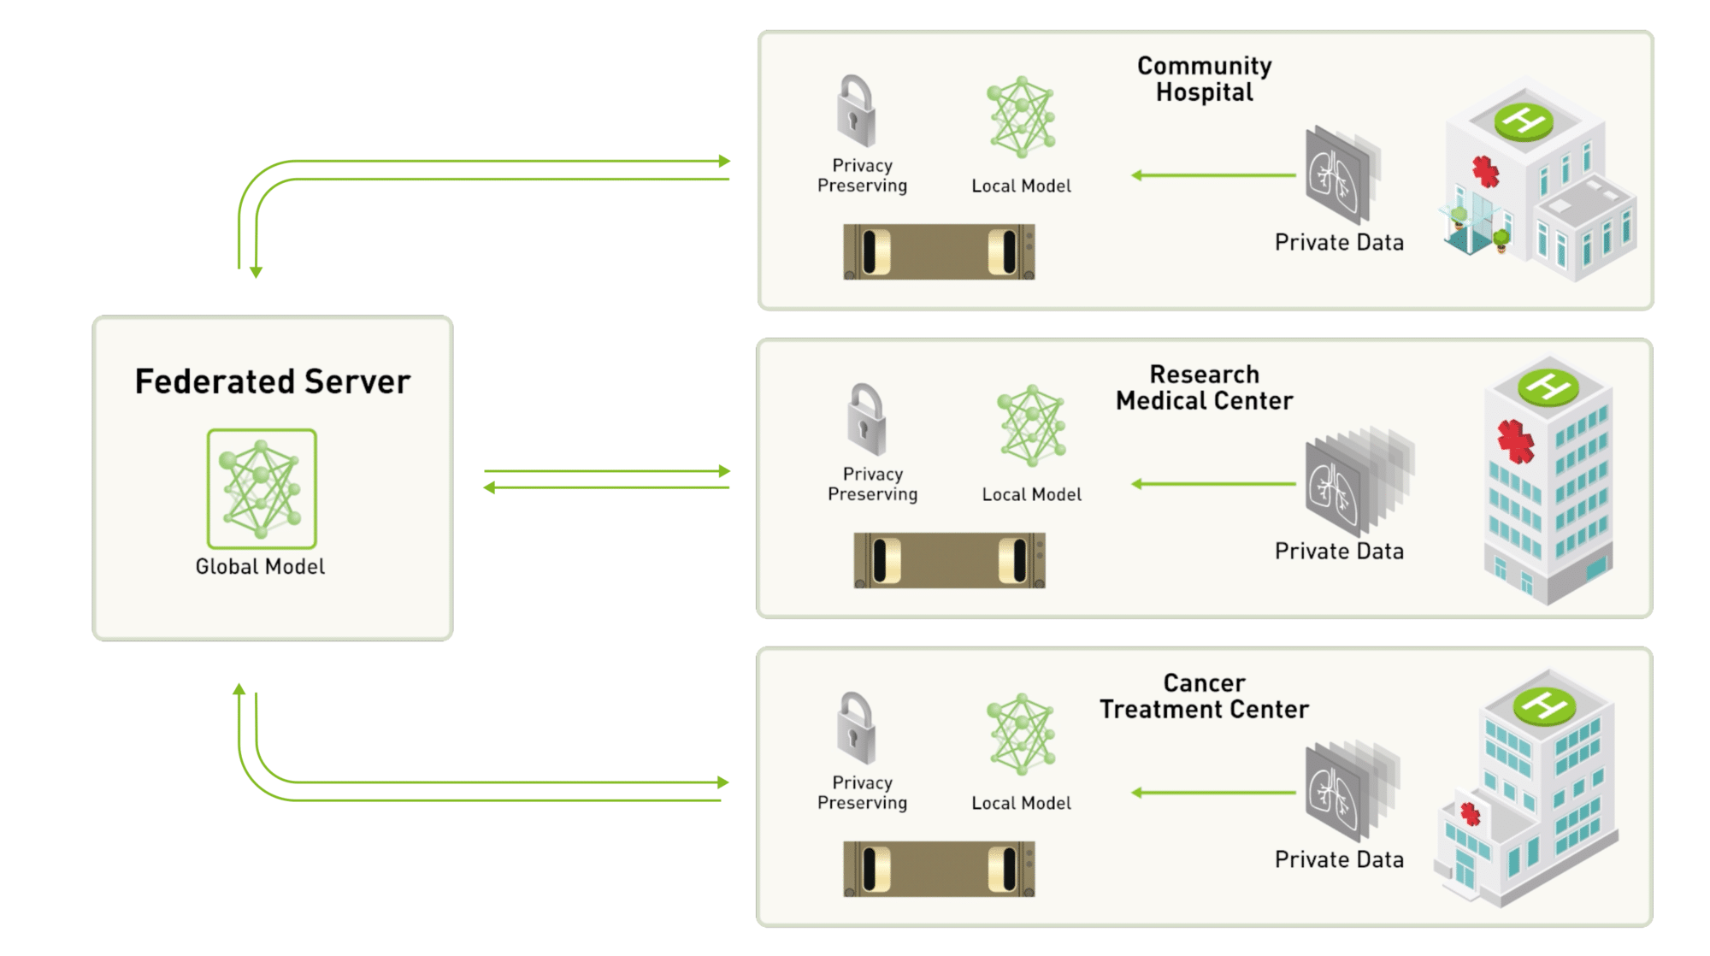
Federated Learning Pipeline
16th October 2021
Abhilash Datta

Slide 2
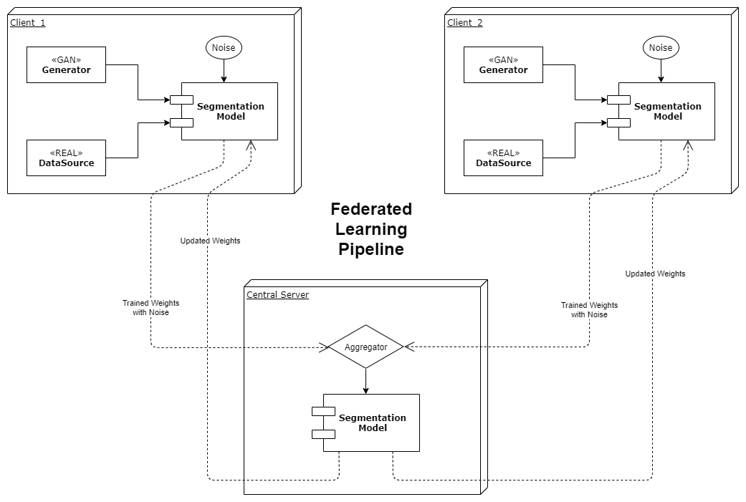
Block Diagram

Slide 3
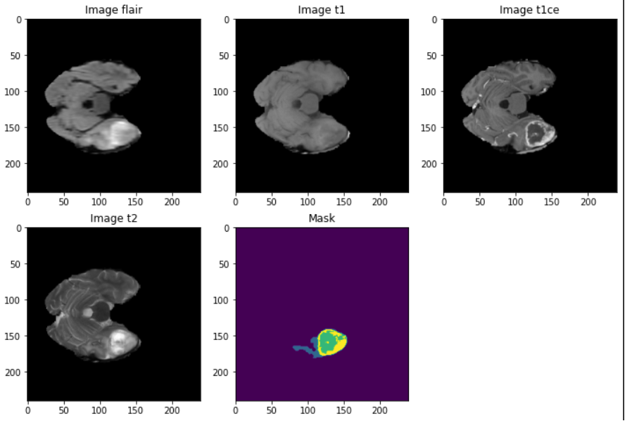
BraTS Dataset
Dataset contains 484 training images and corresponding masks splitted into 434 training and 50 validation.
Dimensions of images: 4x240x240x155
Dimensions of masks: 1x240x240x155
After processing dimensions-
Image: 3x128x128x48
Mask: 4x128x128x48

Slide 4
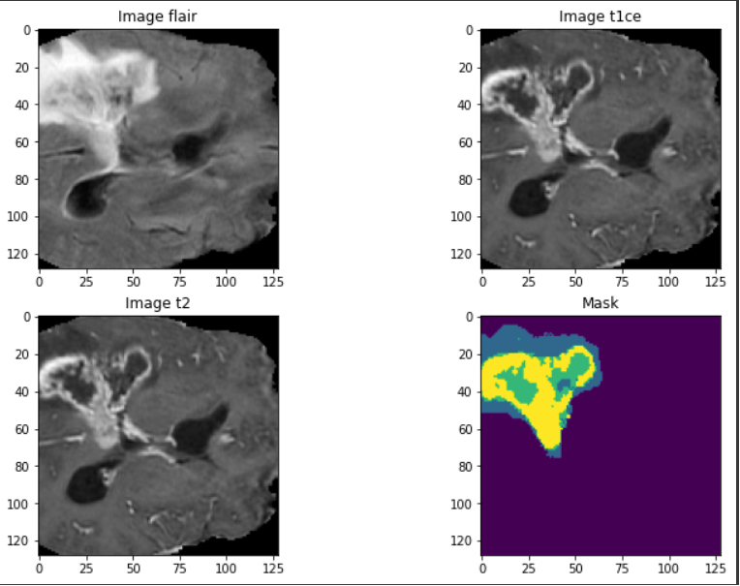
Glimpse of Data
After preprocessing

Slide 5
Main Features
More images for training are generated through WGAN-GP trained on BraTS.
Segmentation is being carried out using UNET3D with Squeeze-Excitation.
FocalTverskyLoss is used for loss calculation instead of DiceLoss.
Uniform Normal distribution is being used for generation of noise in federated pipeline.

Slide 6
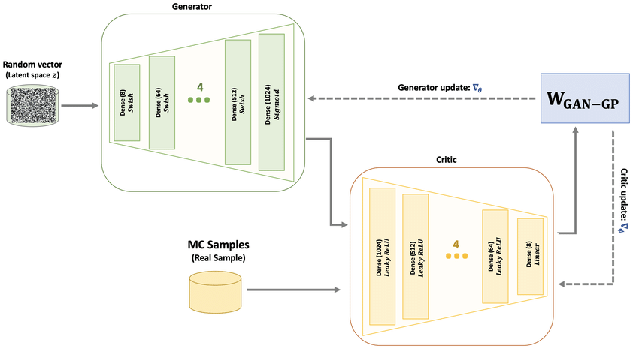
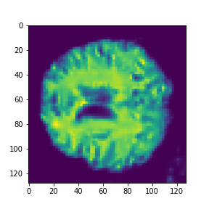
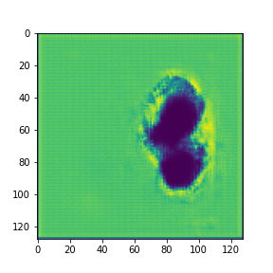
WGAN-GP
Wasserstein GAN with Gradient Penalty: for Generation of more training images
Generated Images

Slide 7
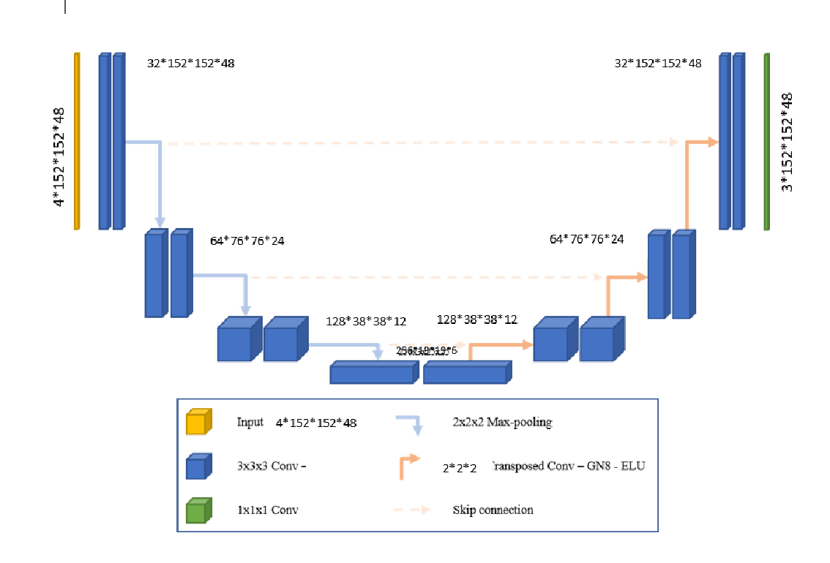
UNET3D with Squeeze Excitation
Model contains 4 encoder blocks and 3 decoder block followed by 1*1*1 convolution at last layer
Activation function: ReLU
Normalization: Batch Normalization
Upsampling: Transposed convolution
Biases are initialized by zeros and weights by kaiming_uniform
Concatenated along channel dimensions.
For Segmenting brain tumors
Courtesy: Gayatri Deshmukh

Slide 8
Federated
Learning
Federated learning is a novel paradigm for multi-institutional collaborations, where model-learning uses all available data without sharing it between institutions, by distributing the model training across institutions and aggregating their results.

Slide 9
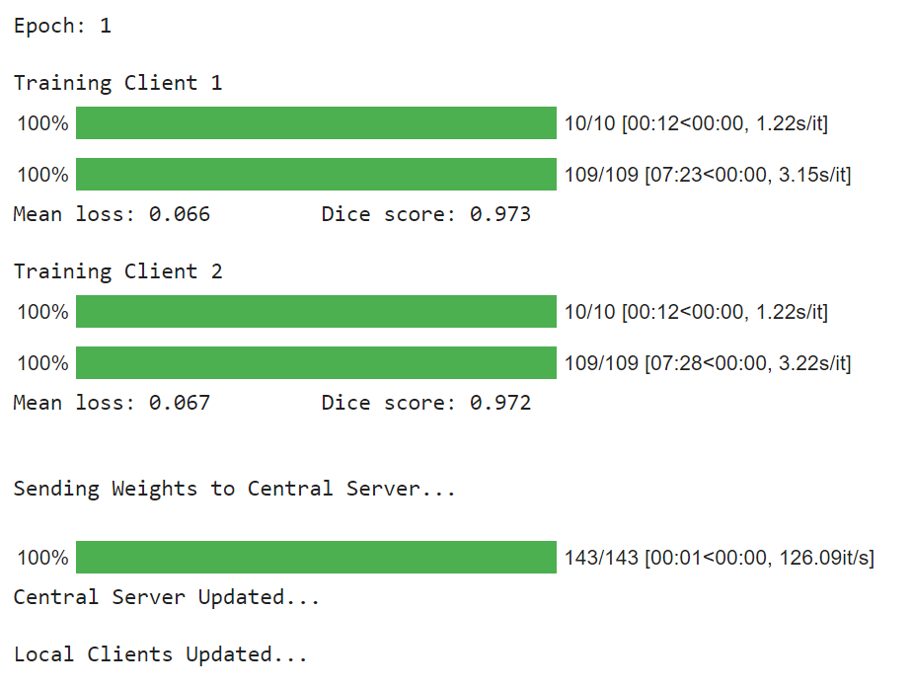
Federated Pipeline Training Epoch

Slide 10
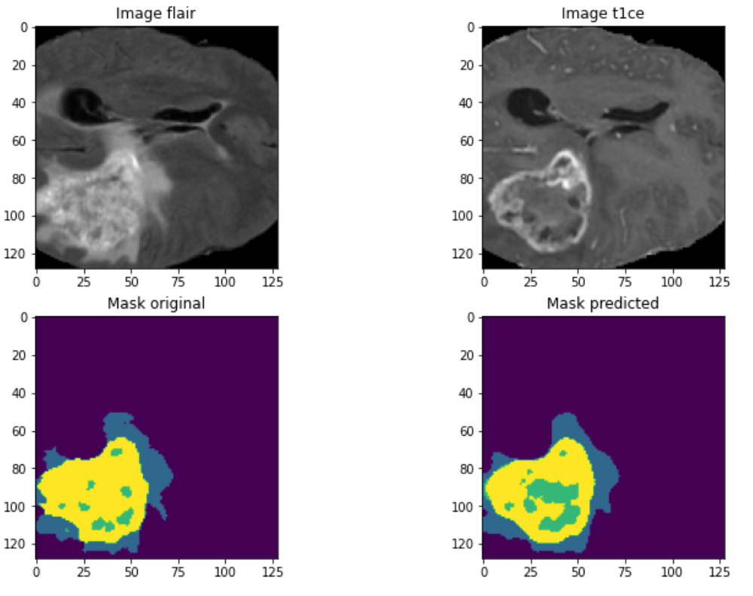
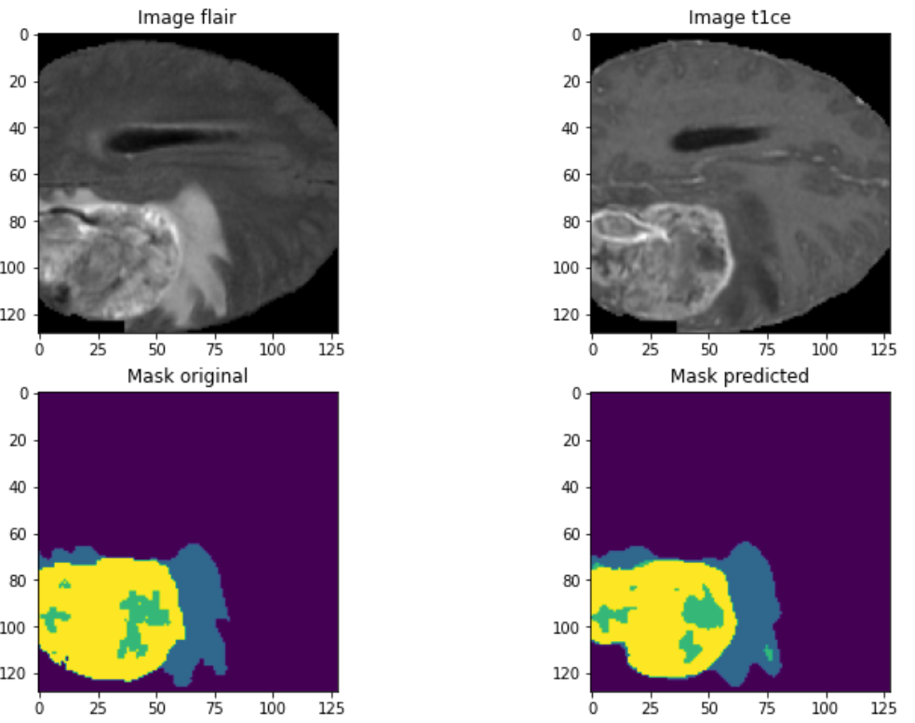
Tumor Segmentation

Slide 11
Variation of Dice Score with number of Generated Images
(with real data)
Percentage of Generated Images added to real data | Training Dice Score | Validation Dice Score
0 | 0.979 | 0.978
10 | 0.938 | 0.976
30 | 0.908 | 0.976
50 | 0.894 | 0.974
70 | 0.886 | 0.976
100 | 0.879 | 0.977
140 | 0.876 | 0.973
230 | 0.873 | 0.976

Slide 12
Variation of Dice Score with number of Generated Images
(without real data)
Percentage of Generated Images | Training Dice Score | Validation Dice Score
10 | 0.969 | 0.786
30 | 0.972 | 0.774
50 | 0.973 | 0.742
70 | 0.974 | 0.775
100 | 0.974 | 0.792
140 | 0.975 | 0.779
230 | 0.975 | 0.775
Dice scores after 2 epoch of training

Slide 13
Federated Training Results
98%
Dice Score for
Brain Tumor
Achieved a dice score of 0.98 for Brain Tumor Segmentation

Slide 14
Links & References
WGAN: Link To 3dbraingen Github
UNET3D: Link To BrainSeg Notebook
Federated Learning: Link To Fed_ABIDE Github

Slide 15
That’s All!
Innovative Ideas are welcomed anytime.
Thank You

